Slide 1
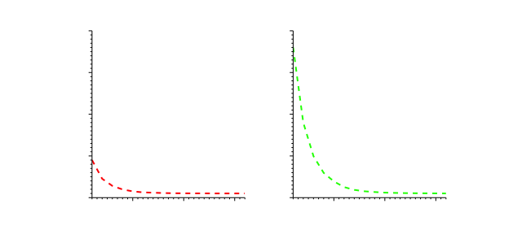
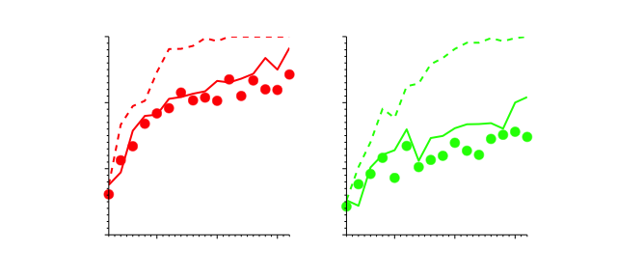
Familiar
Novel
A
1.0
0.8
% accuracy
0.6
0.4
5
10
15
5
10
15
B
40
30
nb candidates
20
10
0
5
10
15
5
10
15
trial
trial

